Slide 1

F1 Race Orientation using ML
A Mini Project by
Prathamesh More | (23106065)
Harsh Kalsekar | (23106042)
Mayuresh Keni | (23106038)
Under the guidance of
Prof. Shraddha Dalvi
Academic Year 2025-26

Slide 2
Presentation Outline:
Introduction
Literature Survey of existing systems
Limitations in existing systems
Problem Statement
System Design & Workflow
Technologies & Methodologies
Implementation Screenshots
Conclusion
References

Slide 3
Introduction:
Formula 1 (F1) is a highly competitive motorsport where race outcomes are influenced by multiple factors such as driver skill, team performance, pit stop strategy, lap times, and weather conditions. Predicting race results is a complex problem because these factors interact in non-linear and often unpredictable ways.
Machine Learning (ML) provides an effective way to capture these patterns from historical race data and generate predictions. In this project, we focus on building a Race Prediction System using two powerful ML algorithms:
XGBoost (Extreme Gradient Boosting) – a high-performance gradient boosting algorithm well-suited for structured/tabular data, capable of handling missing values, feature interactions, and non-linear relationships.
Support Vector Machine (SVM) – a robust algorithm for classification and regression tasks that finds the optimal decision boundary in high-dimensional space, making it effective for handling complex datasets with fewer samples.

Slide 4
Problem Statement:
Predicting the outcome of Formula 1 races is a complex challenge due to the influence of multiple dynamic factors such as driver performance, pit stops, lap times, team strategies, and weather conditions. Existing machine learning models often fail to capture these interactions effectively, leading to inaccurate or inconsistent predictions. Therefore, there is a need to develop an advanced race prediction system that integrates key parameters and leverages powerful algorithms like XGBoost and SVM to improve prediction accuracy and adaptability under varying race conditions.

Slide 5
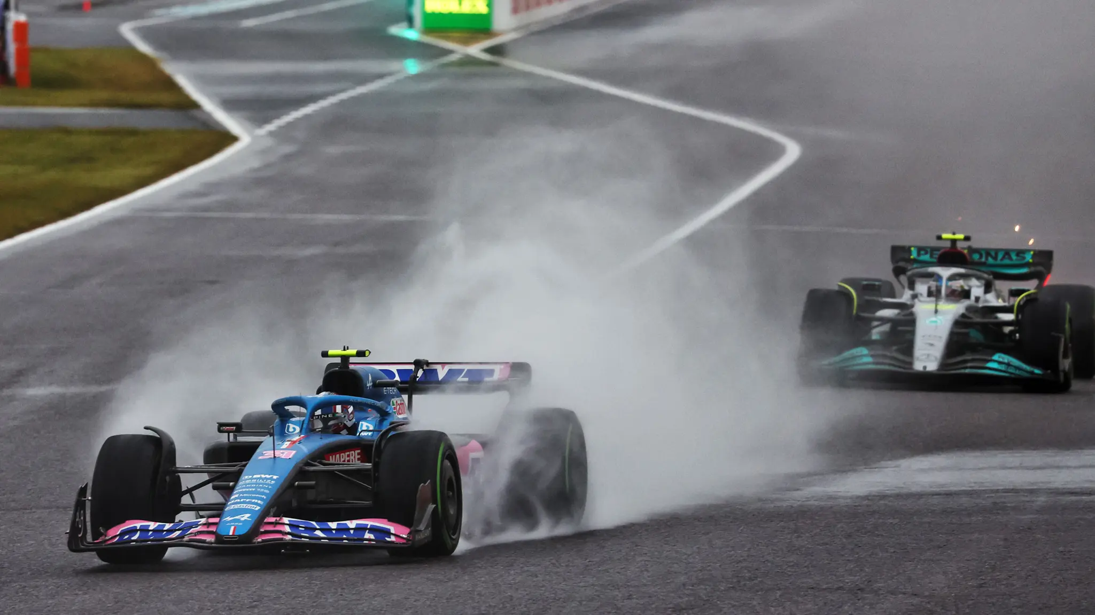
Sustainable Development Goal:
Sustainable Cities and Communities → Motorsport data analysis can inspire better traffic flow optimization and predictive analytics in urban transportation systems
Climate Action → By integrating weather and efficiency-related features, your model can help simulate sustainable strategies that might eventually contribute to energy-efficient racing and eco-friendly vehicle technologies

Slide 6
Literature survey:
Author(s) & Year | Method | Findings / Limitations
Smith et al. (2015) | Logistic Regression, Bayesian | Used qualifying & team strength; limited for dynamic race events
Gupta & Rao (2018) | Random Forest | Predicted finishing positions; ignored pit stops & weather
Fernández et al. (2019) | SVM | Accurate lap classification; struggled with noisy race data
Wang & Li (2020) | LSTMs (Deep Learning) | Improved lap predictions; high computation & incomplete telemetry issues
Khan et al. (2021) | XGBoost | Outperformed regression/SVM; lacked pit stop & weather integration

Slide 7
Limitations in existing systems:
Ignored Key Factors – Many models overlooked pit stops, lap times, and weather conditions.
Struggled with Real-Time Dynamics – Could not adapt well to sudden race events like crashes or safety cars.
Data Quality Issues – Faced problems with noisy, incomplete, or inconsistent telemetry data.
High Computational Cost – Advanced models (e.g., LSTMs) required heavy computation and lacked efficiency.

Slide 8
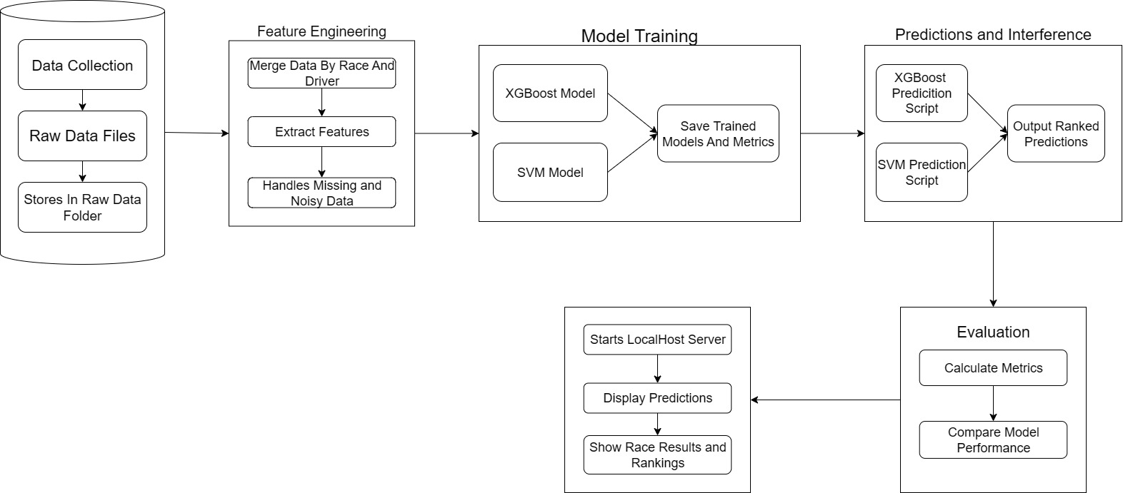

System Workflow:

Slide 9
System Design:
Feature Engineering:
Merge all data by raceId and driverId
Extract key features: pit stops, average lap time, weather, team stats.
Model Training:
XGBoost: For high accuracy and feature importance.
SVM Bot: For comparison and handling complex patterns.
Prediction / Inference:
Scripts: predict.py (XGBoost), svm_predict.py (SVM).

Slide 10
Evaluation:
Metrics: MAE, RMSE, accuracy, rank correlation.
Compare XGBoost and SVM performance.
Optional API / Dashboard:
Flask or FastAPI for live predictions.
Display race results, driver ranking, and feature importance.
Advantages:
Integrates weather, lap, and pit data.
Uses dual models (XGBoost + SVM) for better adaptability.

Slide 11
Technologies & Methodologies:
Machine Learning Libraries: XGBoost – for gradient boosting race prediction, Scikit-learn (SVM, preprocessing, metrics) – for SVM Bot and evaluation, Pandas NumPy – for data manipulation and analysis
Model Deployment:
Flask – to build an API for predictions
Joblib – to save and load trained models
Development Environment:
VS Code – coding, debugging, and version control (Git integration)

Slide 12
Database / Storage:
CSV – for storing race, lap, and weather data
Front-End:
HTML,CSS,JAVASCRIPT– for building a cross-platform mobile app to display race predictions and analytics

Slide 13
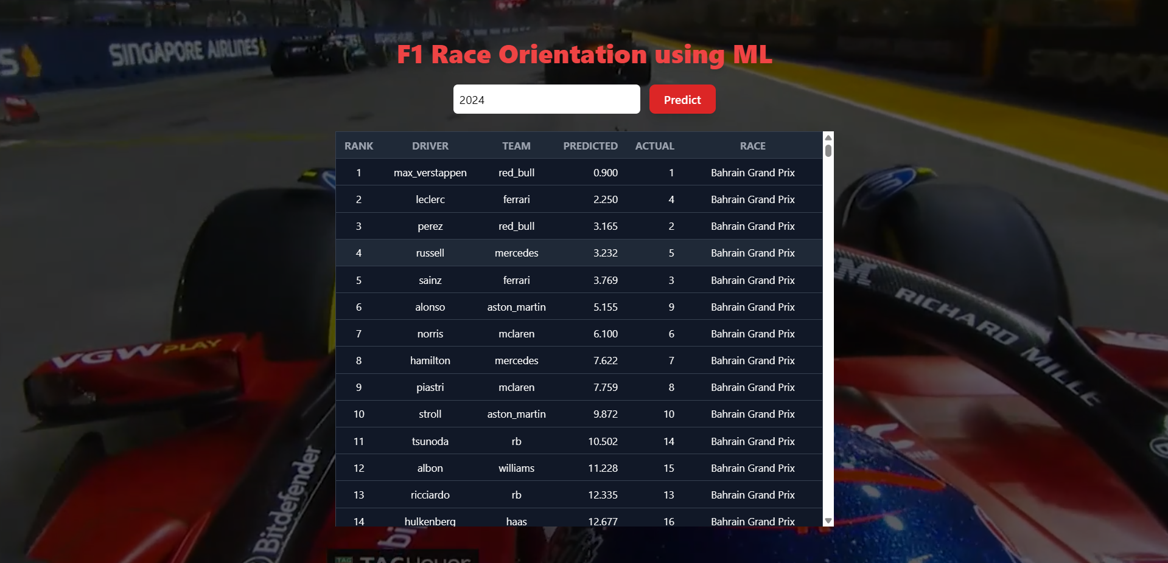
Implementation:

Slide 14
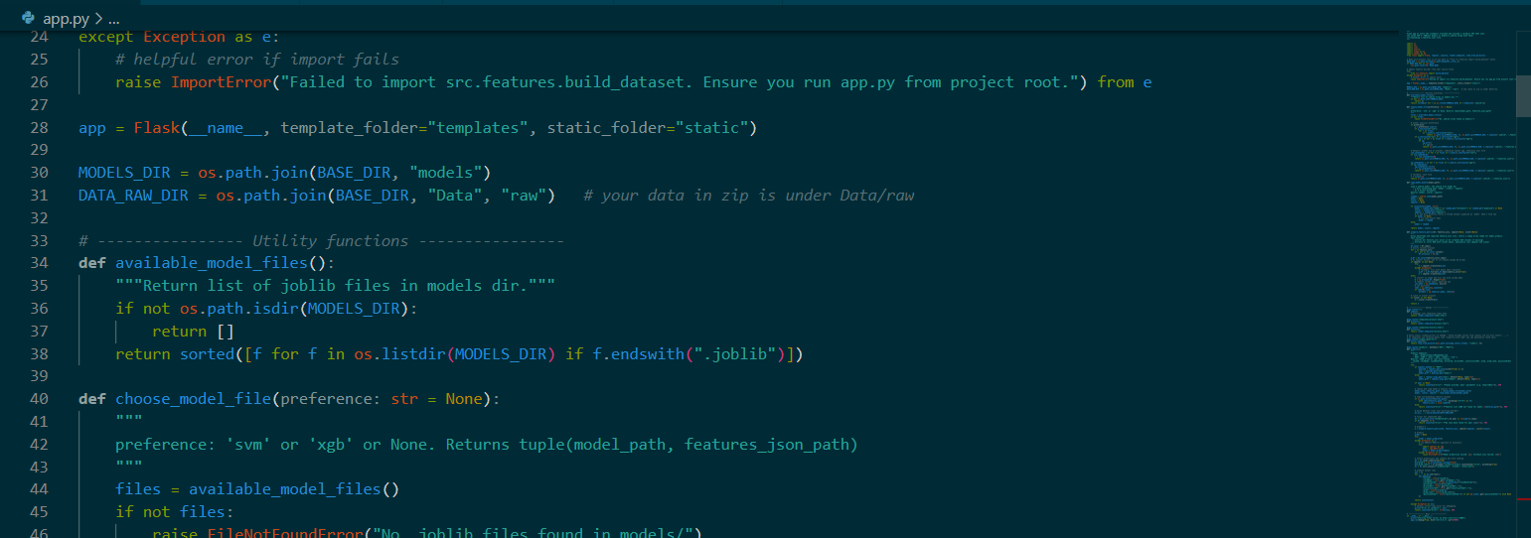
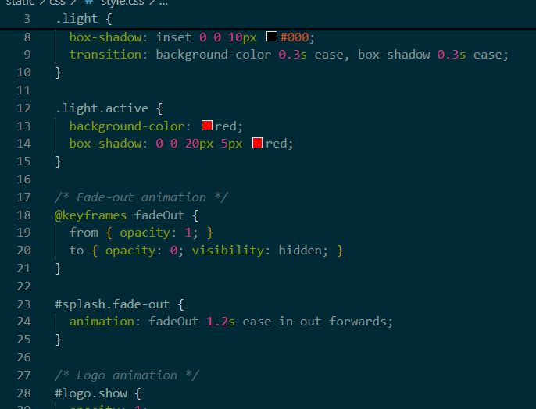
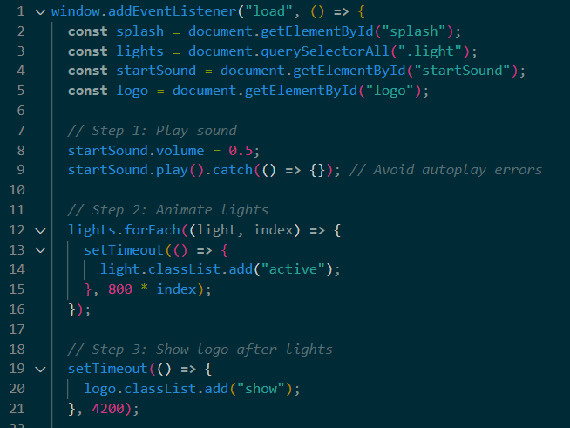
Implementation:

Slide 15
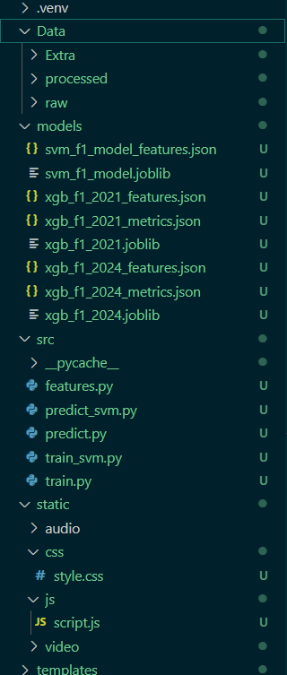
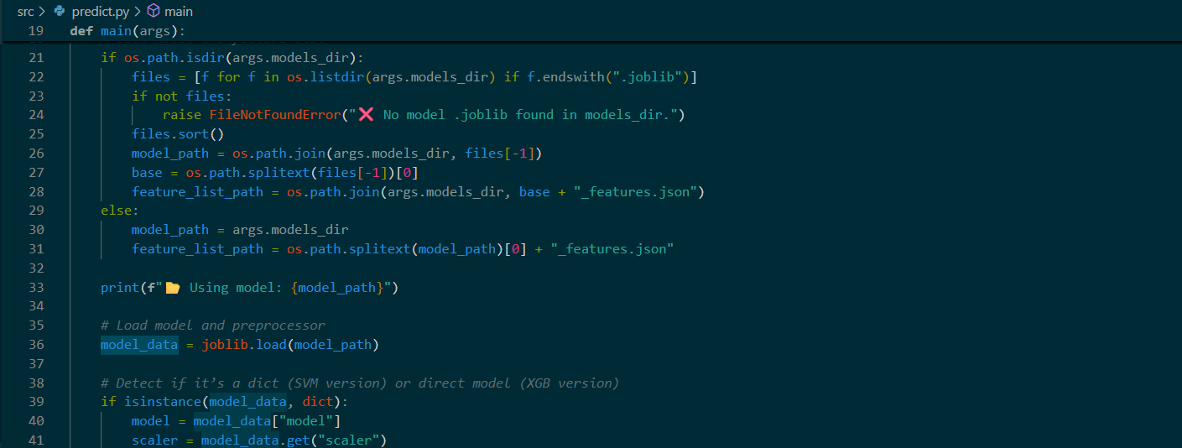
Implementation:

Slide 16
CONCLUSION:
The F1 Race Prediction project successfully demonstrates the use of Machine Learning algorithms, specifically SVM (Support Vector Machine) and XGBoost, to forecast race outcomes based on historical race data, driver performance, and track conditions. The models were able to capture complex patterns and make accurate predictions, highlighting the potential of ML in motorsports analytics.
This approach not only assists teams and strategists in decision-making but also opens avenues for real-time predictive insights, enhancing race strategies and performance optimization. Future improvements can include incorporating real-time telemetry data, weather conditions, and advanced feature engineering to further increase prediction accuracy.

Slide 17
References:-
[1] T. Kumar and A. Singh, “Race outcome prediction using machine learning models in Formula 1,” International Journal of Data Science and Analytics, vol. 8, no. 3, pp. 210–218, 2021.
[2] P. Sharma and R. Patel, “Driver performance classification using Support Vector Machines for Formula racing,” IEEE Access, vol. 10, pp. 45120–45130, 2022.
[3] H. Lee, J. Park, and K. Choi, “Predictive analysis of pit stop strategies in Formula 1 using XGBoost,” Journal of Sports Analytics, vol. 9, no. 1, pp. 55–68, 2023.
[4] Y. Chen and L. Zhang, “Deep learning approaches for motorsport telemetry data prediction,” Procedia Computer Science, vol. 219, pp. 980–989, 2024.
[5] F. Zhou, M. Wilson, and A. Gupta, “Comparative analysis of machine learning algorithms for race performance forecasting,” Expert Systems with Applications, vol. 214, 2023.

Slide 18
THANK YOU

